Slide 1
CHARITABLE GAMING
GAMES OF CHANCE (GOC) OPERATOR RENEWAL

Slide 2
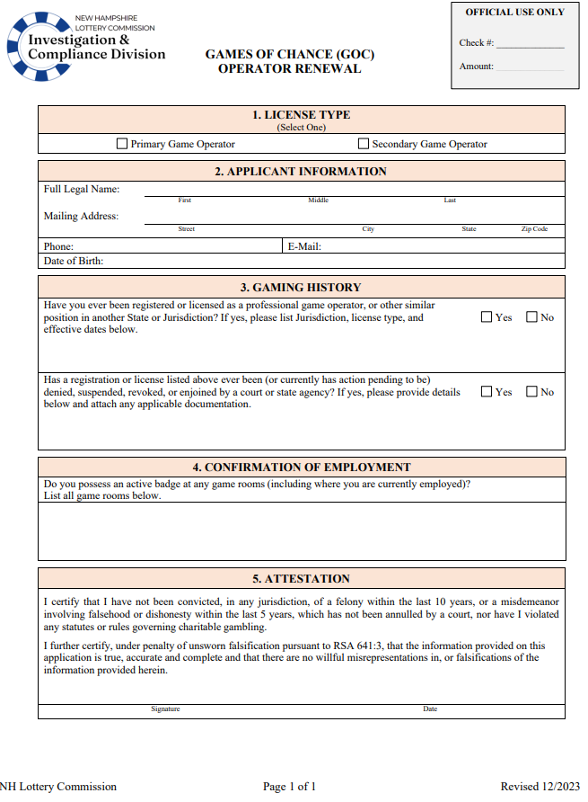
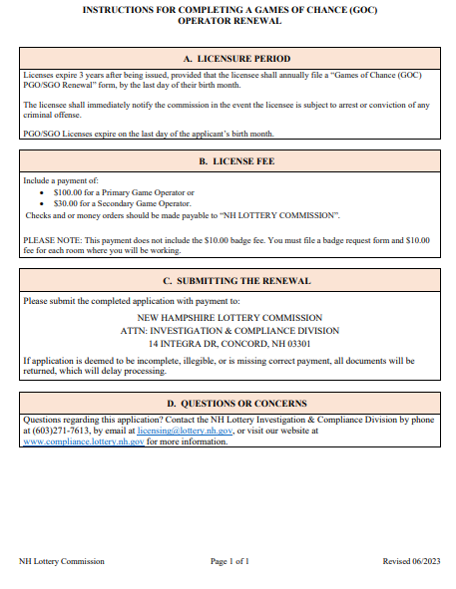
GAMES OF CHANCE (GOC) OPERATOR RENEWAL
The purpose of this presentation is to aid in completing and submitting a Games of Chance (GOC) Operator Renewal
Game Operators must submit a renewal annually before the last day of their birth month

Slide 3
GAMES OF CHANCE (GOC) OPERATOR RENEWAL
SECTIONS 1 & 2
License Type
Indicate which type of license is being sought:
Primary Game Operator
Secondary Game Operator
Applicant Information
Applicant must provide their full legal name, mailing address, phone number, email, and date of birth

Slide 4
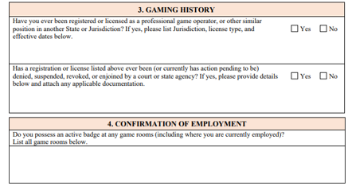
GAMES OF CHANCE (GOC)
OPERATOR RENEWAL
SECTIONS 3 & 4
Gaming History
Indicate “yes” or “no” to the questions below
If “yes” is the answer to either questions additional documentation is required to accompany the renewal
List ALL New Hampshire Game Rooms where applicant currently works. This section must include AT LEAST one Game Room
Confirmation of Employment

Slide 5
GAMES OF CHANCE (GOC)
OPERATOR RENEWAL
SECTION 5
Carefully read the attestation before signing

Slide 6
A payment, by check or money order, in the amount of:
Checks and/or money orders must be made payable to:
“NH LOTTERY COMMISSION”
$100.00 for a Primary Game Operator, or; $30.00 for a Secondary Game Operator
FEES

