Slide 1
CHARITABLE GAMING
PRIMARY AND SECONDARY GAME OPERATOR APPLICATION

Slide 2
OBJECTIVE
The purpose of this presentation is to aid in completing and submitting Primary and Secondary Game Operator applications.
Topics to review will include:
Different types of Game Operator licenses
Licensure period
Games of Chance (GOC) PGO/SGO Application
Supporting Documentation
Review of the State Police portal

Slide 3
TYPES OF OPERATOR LICENSES
Primary Game Operator (PGO)
Any person involved in conducting, managing, supervising, directing, or running games of chance;
Examples:
gambling operation managers
assistant managers
managers and supervisors of security,
employees
pit bosses
shift bosses
credit executives
cashier operations supervisors.
Secondary Game Operator (SGO)
Any person involved in dealing, running a roulette wheel, handling chips, or providing accounting services or security functions; including any person with job functions or responsibilities that require the person to watch over, protect, handle, use, maintain, or otherwise hold responsibility over gaming cash, revenue, supplies, or devices.
Examples:
individuals in the back office
anyone that has access to gaming systems, chips, tokens, or playing cards
anyone who could access or make changes to the gaming operations accounting system, player tracking system, gaming system records, or cash and accounting records.

Slide 4
LICENSURE PERIOD
Licenses expire 3 years after being issued, provided that the licensee annually renew.
The licensee shall immediately notify the commission in the event they are subject to arrest or conviction of any criminal offense.
PGO/SGO licenses expire on the last day of the applicant’s birth month.
*See Renewal PowerPoint for more information on the renewal process.

Slide 5
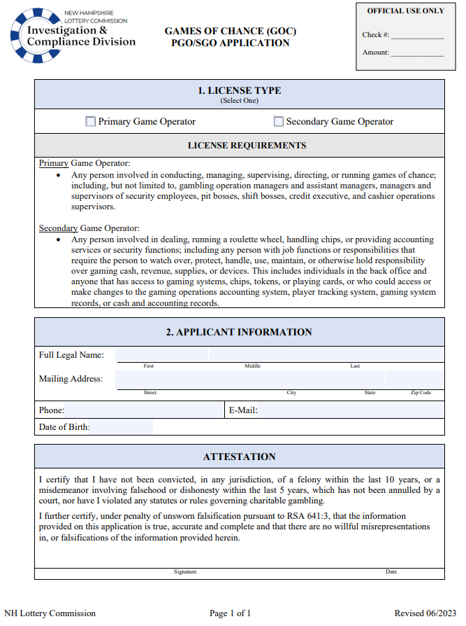
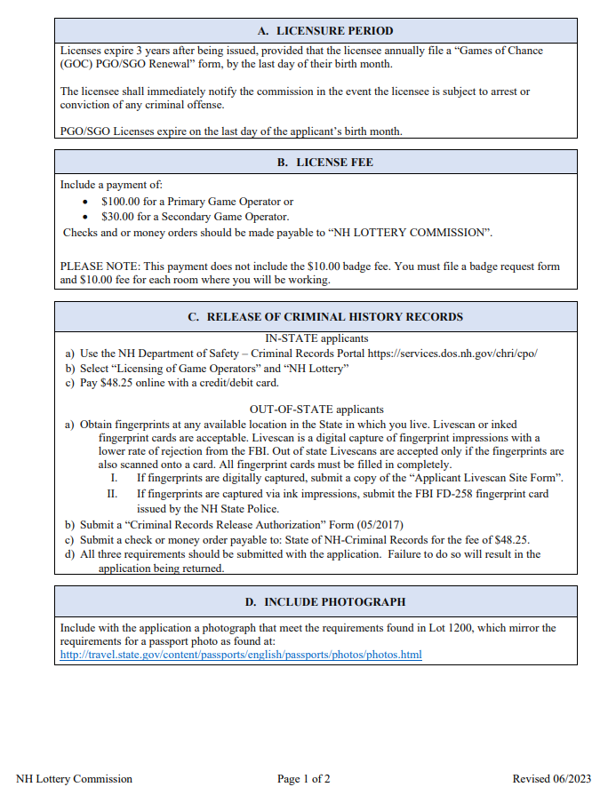
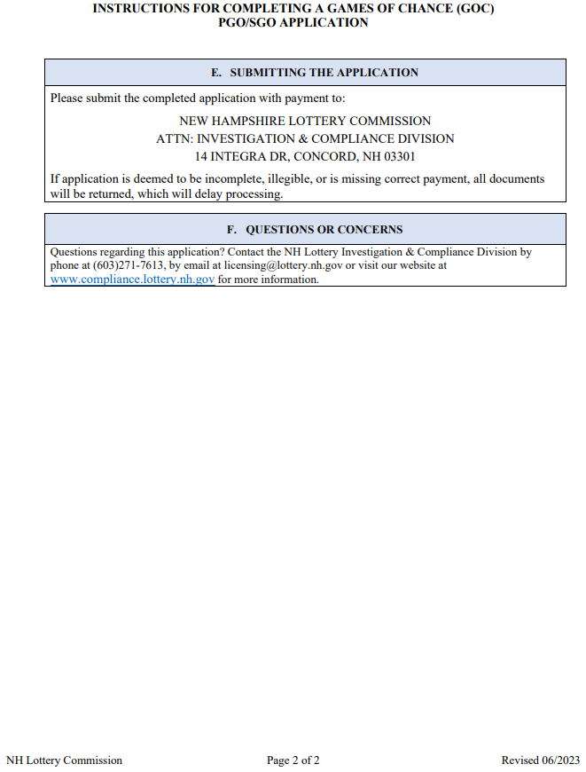
GAMES OF CHANCE (GOC) PGO/SGO APPLICATION
A badge Request form for each room where applicants are requesting to work. Please see the corresponding PowerPoint for more information

Slide 6
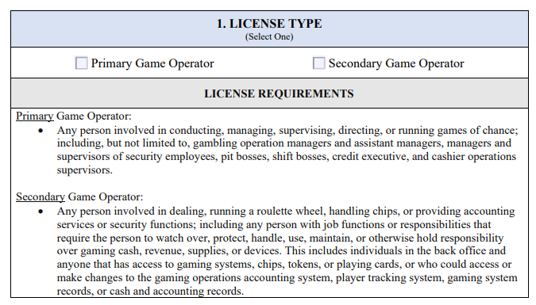
GAMES OF CHANCE (GOC) PGO/SGO APPLICATION SECTION 1
License Type Section 1
Choose the appropriate license type.

Slide 7
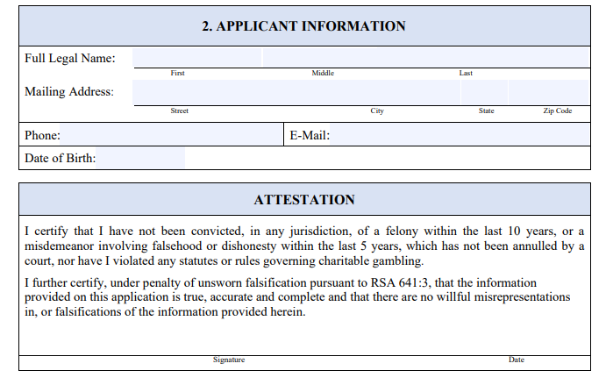
GAMES OF CHANCE (GOC) PGO/SGO APPLICATION SECTIONS 2 & 3
Applicant Information Section 2
Enter full name including middle and any applicable suffix.
Enter mailing address and phone number.
Notifications are sent via email. Include an email address that is used frequently.
Licenses expire in the month of birth; a license can not be issued if this field is left blank.
Attestation Section 3
Read the attestation carefully prior to signing.
3.

Slide 8
SUPPORTING DOCUMENTATION
Submit one color photo, taken in last 6 months.
Use a clear image of your face.
Do not digitally retouch or change your photo using computer software, phone apps or filters, or artificial intelligence.
Have someone else take your photo. No selfies.
Take off your eyeglasses for your photo.
Use a white or off-white background without shadows, texture, or lines.
Photos must meet the requirements of a passport photo
Passport photo requirements found at: http://travel.state.gov/content/passports/english/passports/photos/photos.html

Slide 9
A payment, by check or money order, in the amount of:
Checks and/or money orders must be made payable to:
“NH LOTTERY COMMISSION”
$100.00 for a Primary Game Operator, or; $30.00 for a Secondary Game Operator
Confirmation of an FBI background check
To book a portal appointment please see the following slides
SUPPORTING DOCUMENTATION

Slide 10
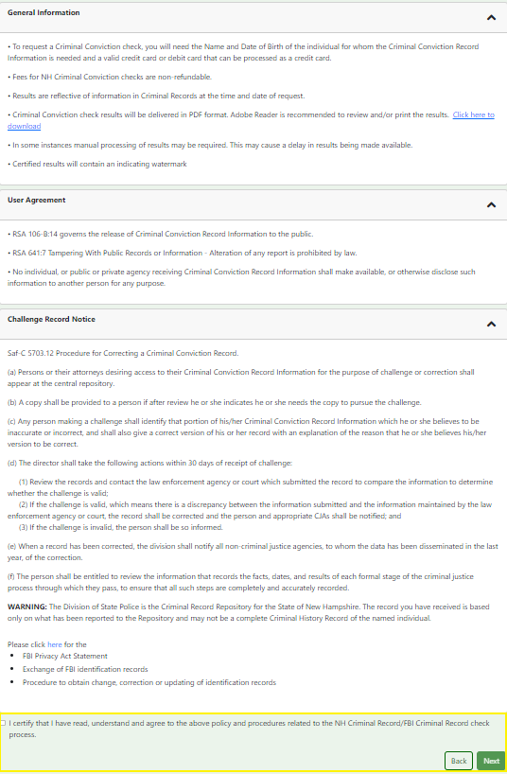
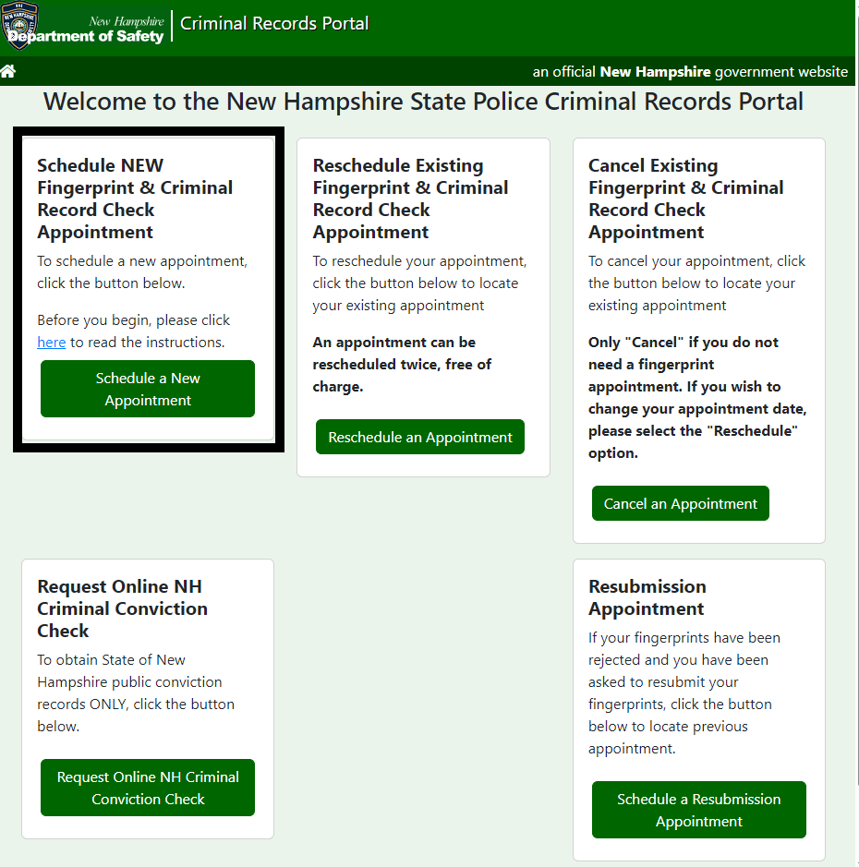
NH DEPARTMENT OF SAFETY – CRIMINAL RECORDS PORTAL
https://services.dos.nh.gov/chri/cpo/
1. Select “Schedule a New Appointment”
2. Carefully read through the information, agreement, and notice before checking the box at the bottom and selecting “Next”

Slide 11
NH DEPARTMENT OF SAFETY – CRIMINAL RECORDS PORTAL
AGENCY SELECTION
3. Use the drop-down boxes to select “Licensing of Game Operations” and “NH Lottery” as shown in the image to the left
Once completed, select “Next”

Slide 12
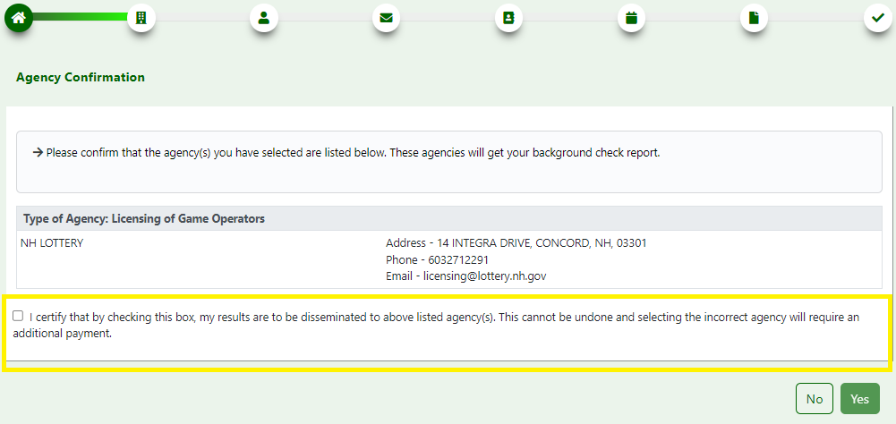
NH DEPARTMENT OF SAFETY – CRIMINAL RECORDS PORTAL
AGENCY CONFIRMATION
4. Confirm the agency selected by checking the box and then selecting “Yes”

Slide 13
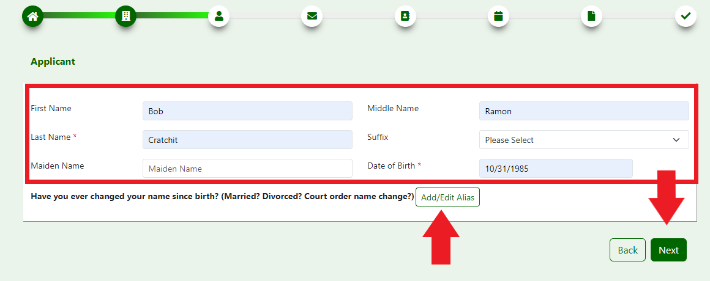
NH DEPARTMENT OF SAFETY – CRIMINAL RECORDS PORTAL
APPLICANT
STEP 5 – Applicants must enter their legal first, middle and last name as well as their date of birth
Select a suffix using the drop-down box, if applicable
Enter maiden name, if applicable
If a name has ever been changed use the “Add/Edit Alias” button
Once completed, select “Next”

Slide 14
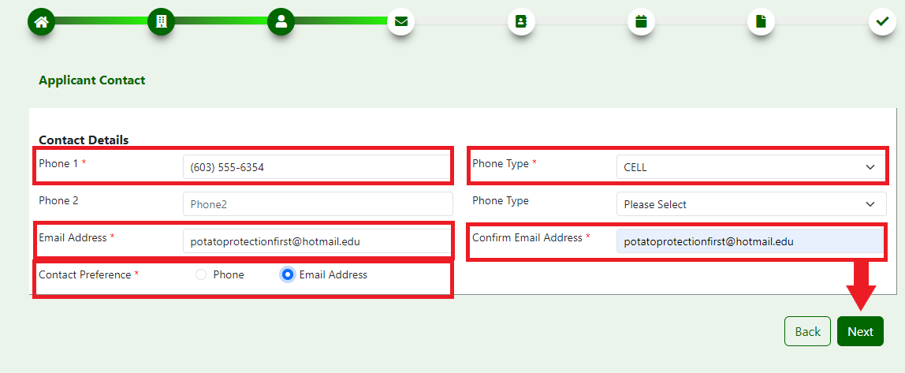
NH DEPARTMENT OF SAFETY – CRIMINAL RECORDS PORTAL
APPLICANT CONTACT
6.
Enter phone number
Use drop-down to select phone type
Enter email address
Confirm email address
Select contact preference
Once completed, select “Next”

Slide 15
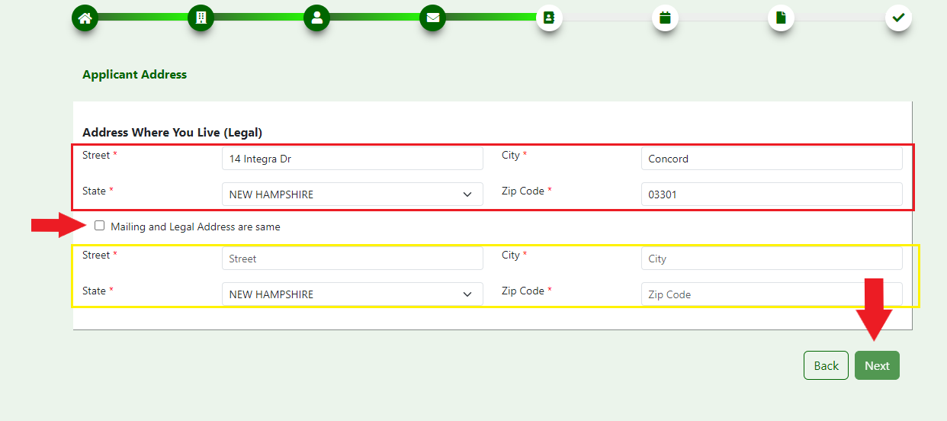
NH DEPARTMENT OF SAFETY – CRIMINAL RECORDS PORTAL
7.
Applicants must enter their legal address.
If mailing address and legal address are the same, check the box
If mailing address and legal address are NOT the same, applicants must enter their mailing address as well
Once completed, select “Next”
APPLICANT ADDRESS

Slide 16
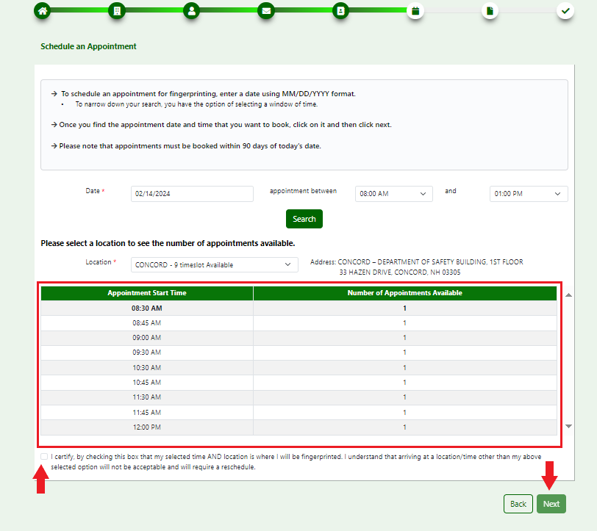
NH DEPARTMENT OF SAFETY – CRIMINAL RECORDS PORTAL
SCHEDULE AN APPOINTMENT
8. Enter the preferred date and time frame for an appointment, select “Search”
STEP 10 – Select the preferred appointment time from the list provided
Check the certification box
Once completed, select “Next”
9. Use the drop-down box to select a location

Slide 17
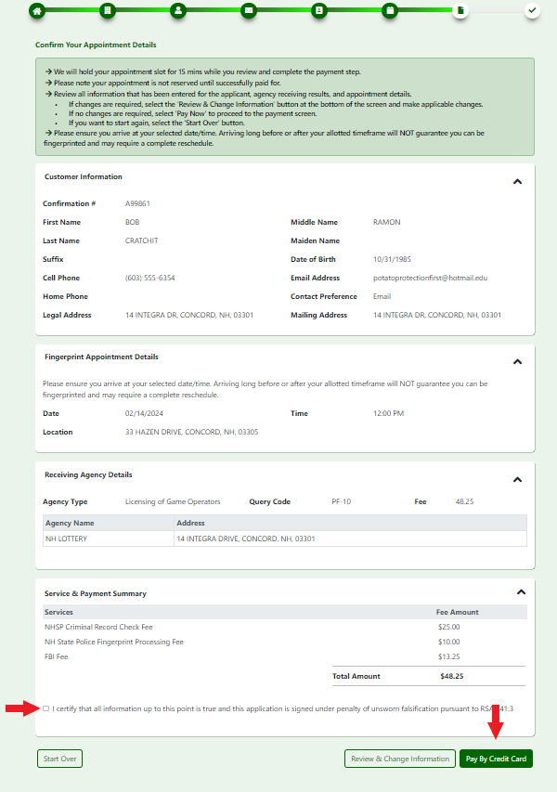
NH DEPARTMENT OF SAFETY – CRIMINAL RECORDS PORTAL
CONFIRM APPOINTMENT DETAILS
11
Verify that all information is correct
Check the certify box at the bottom of the page
Once completed, select “Pay by Credit Card"

Slide 18
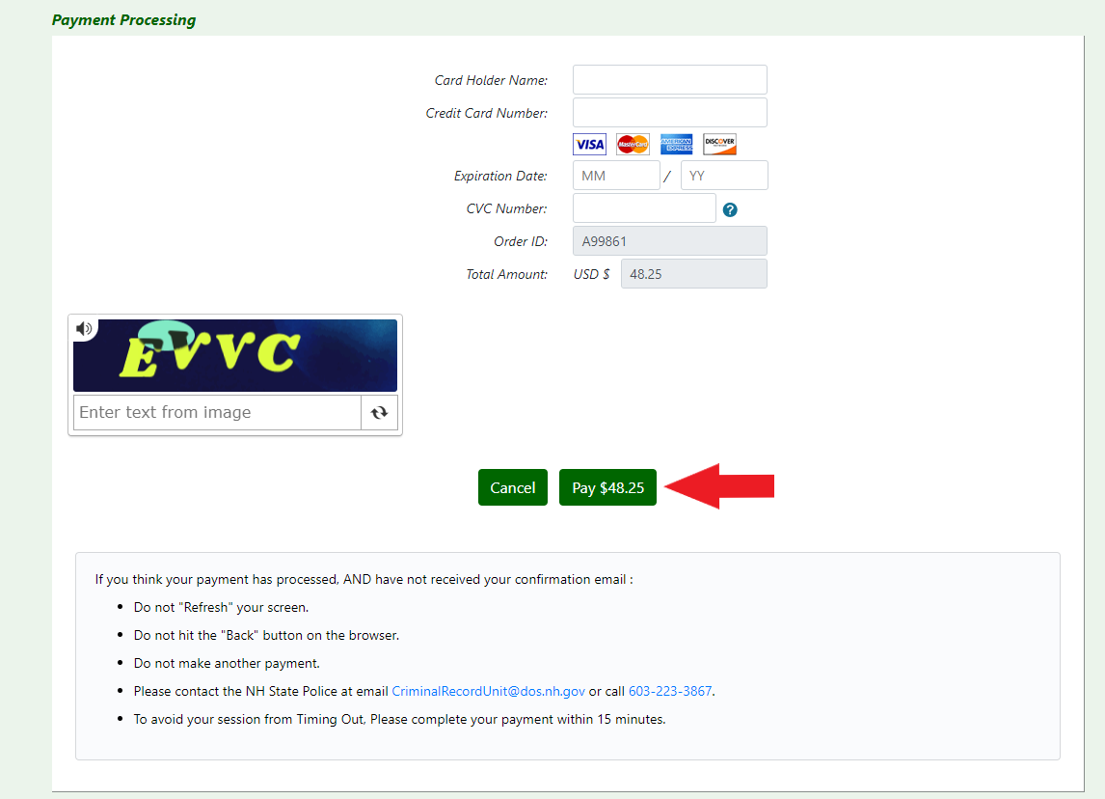
NH DEPARTMENT OF SAFETY – CRIMINAL RECORDS PORTAL
PAYMENT PROCESSING
12.
Enter credit card details
Once completed, select “Pay $48.25”
Print receipt for records

