Slide 1
Monthly Lucky 7 Licenses
CHARITABLE GAMING

Slide 2
OBJECTIVE
The purpose of this presentation is to aid in completing and submitting a Monthly Lucky 7 license application.
Topics to review will include:
Different types of Lucky 7 licenses
Locations for events
Monthly Lucky 7 license application
Compliance expectations
Internal Controls
Inventory
Monthly Financial Reports (MFRs)

Slide 3
Types of Lucky 7 Licenses
Monthly
Must be sold at a Bingo event or licensed Games of Chance facility
Limited to 16 game dates per month
Can be played at a Commercial Hall or other approved location
Issued monthly
Special Events
Sponsored or co-sponsored by an organization
Not associated with Bingo or Games of Chance
Issued once per year for up to four consecutive days
Annual
Not associated with Bingo or Games of Chance
Can be played every day
Played at the organization’s regular meeting place/or a facility owned, leased, or utilized by the organization for activities
Issued annually for up to 12 months within a given calendar year

Slide 4
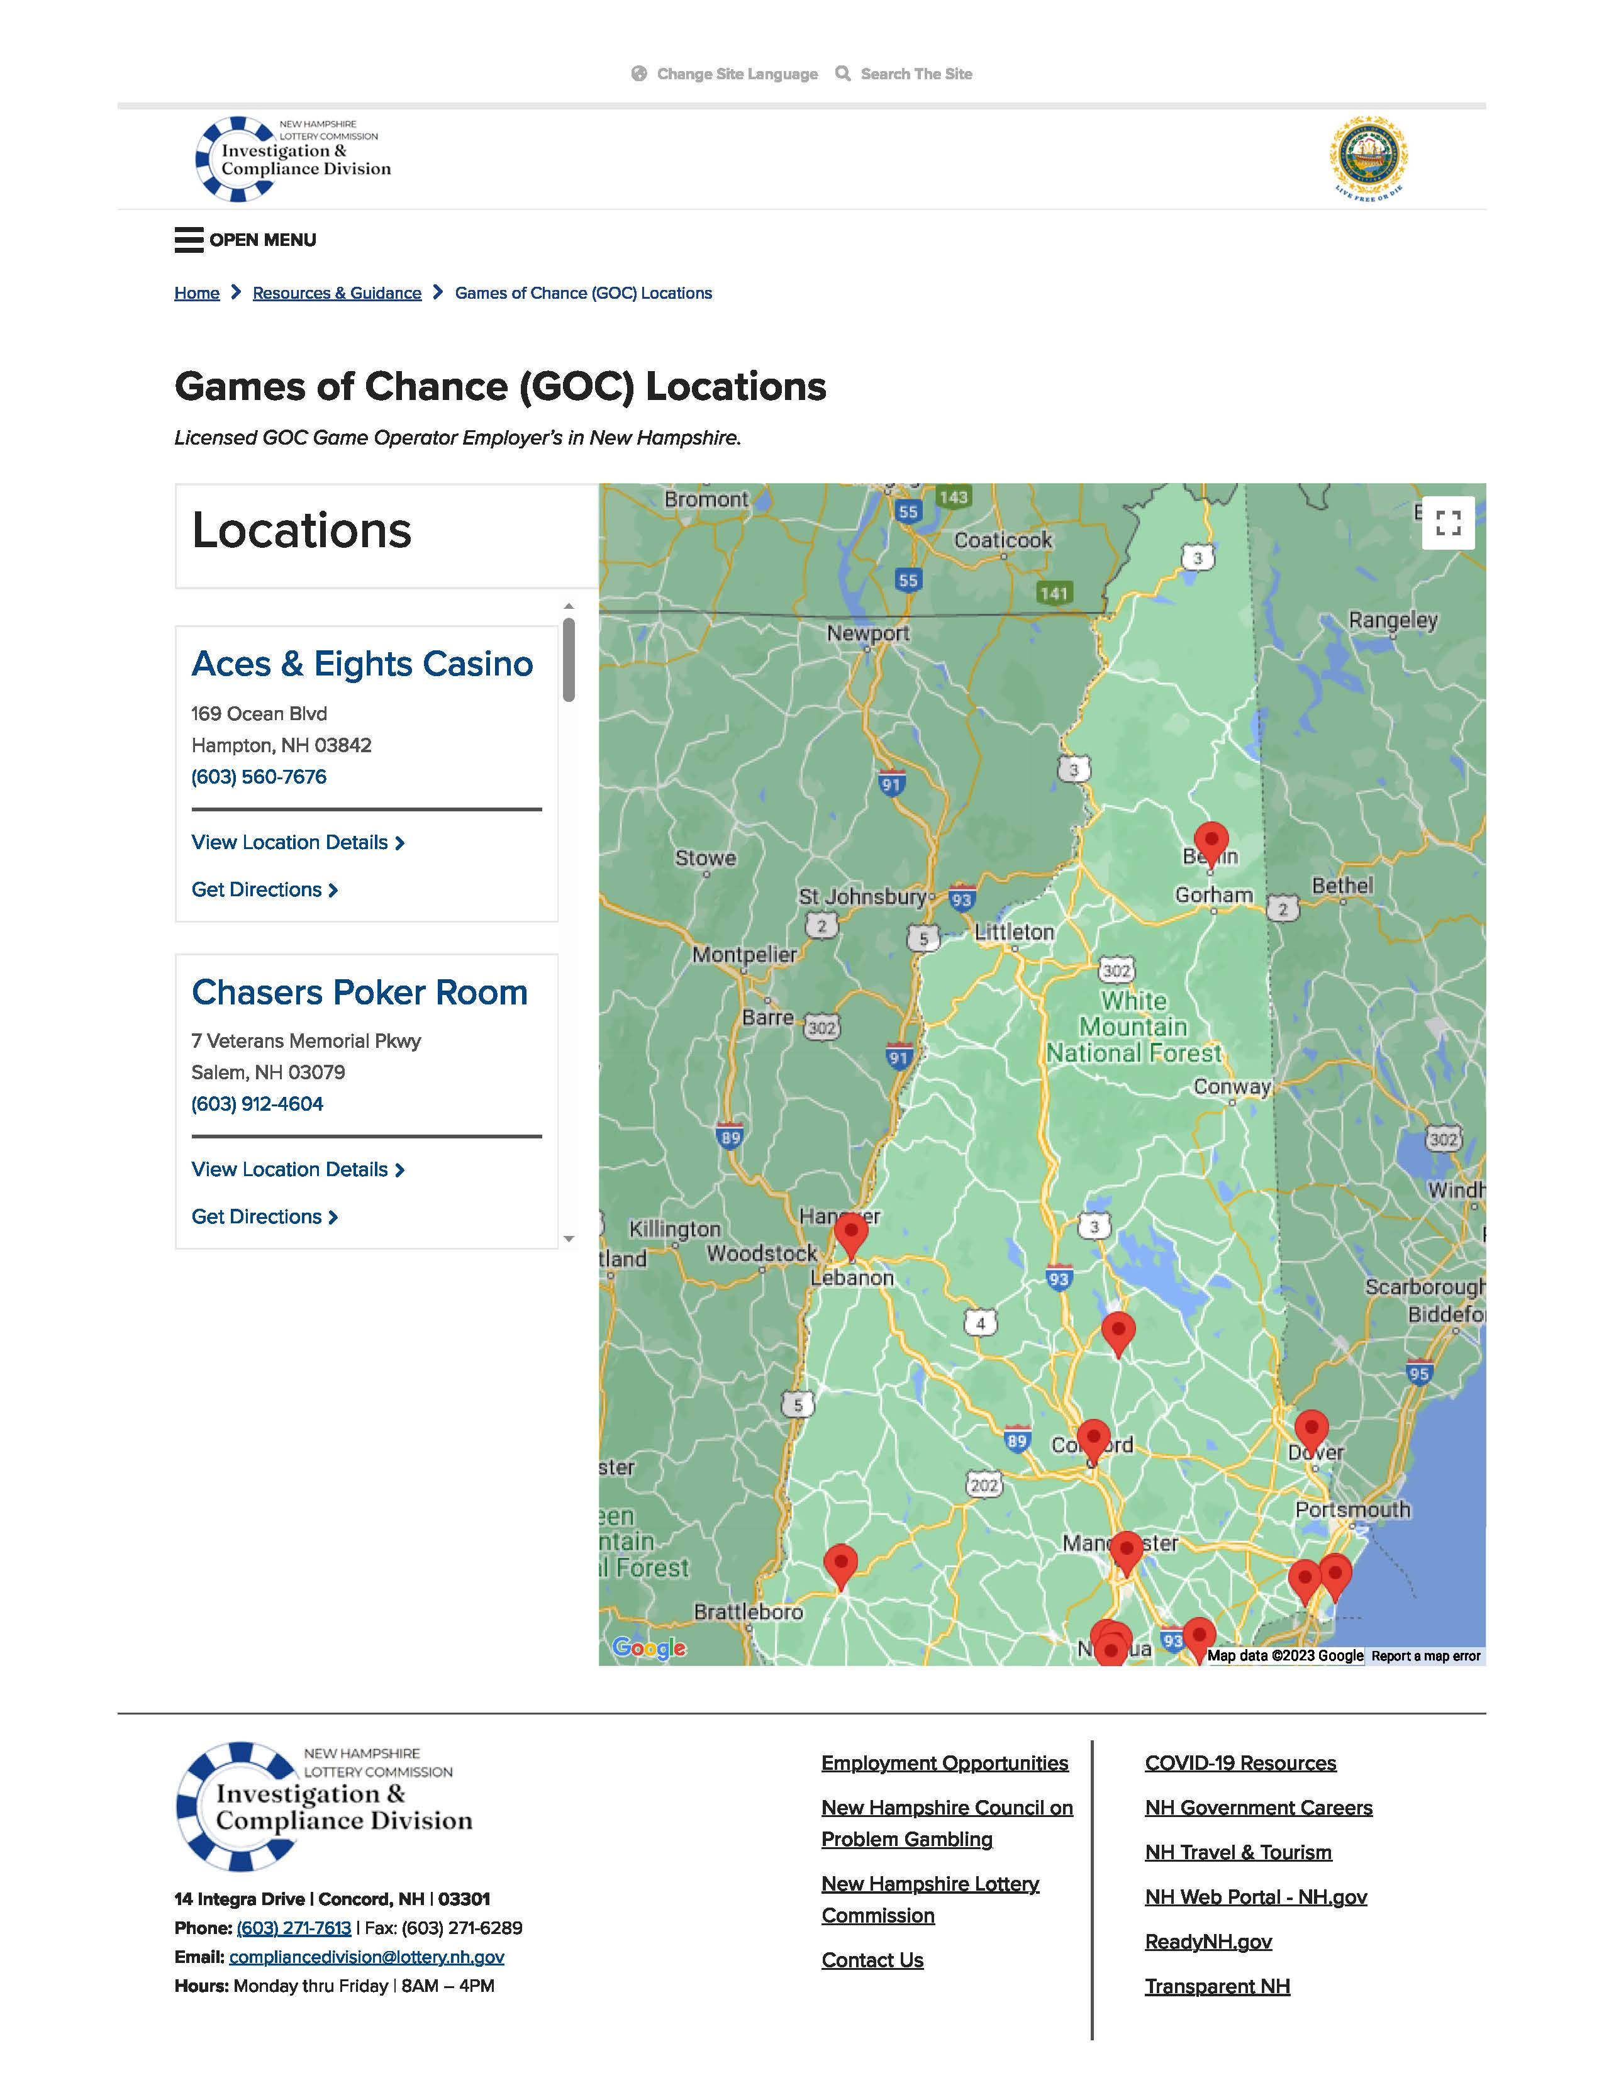
Locations for events
FIND A COMMERCIAL HALL TO HOST
FIND A GAME ROOM TO HOST
* Monthly Lucky 7 may be played at the organization’s regular meeting place/or a facility owned, leased, or utilized by the organization for activities

Slide 5
INFORMATION TO KNOW PRIOR TO CHOOSING A GAMING LOCATION
Can the game room offer the full 16 days?
What is expected of an organization?
What are the average funds received by a charitable organization?
QUESTIONS
TO ASK
Is there a waiting list for charities?
Does the gaming location provide consulting services?
Do charities need to have a member present during assigned dates?

Slide 6
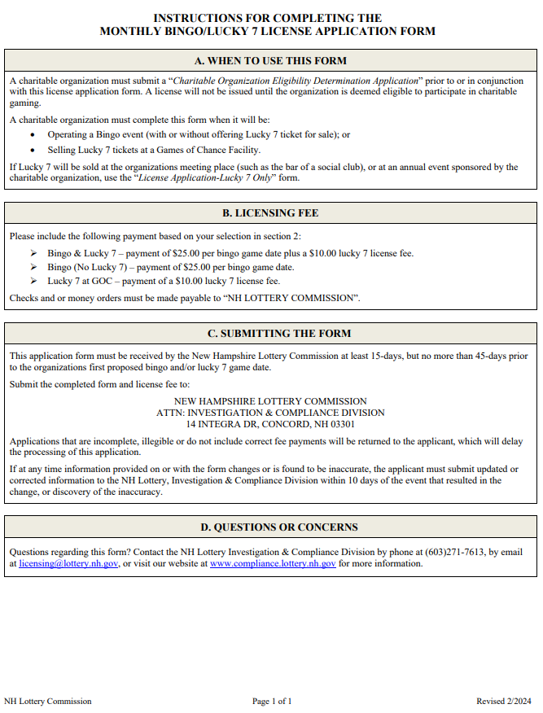
Monthly Lucky 7 license application
An Eligibility Determination Application must be submitted prior to or with this application. For more information regarding the Eligibility Determination Application, see the corresponding PowerPoint.

Slide 7
MONTHLY Lucky 7 LICENSE APPLICATION SECTION 1
ORGANIZATION’S NAME
This must read exactly how it is registered with the IRS, SOS, and CTU
ORGANIZATION’S ADDRESS
This must be the organization’s official mailing address.
ORGANIZATION’S PHONE NUMBER & EMAIL
Phone number and Email must belong to the organization and must be actively monitored.

Slide 8
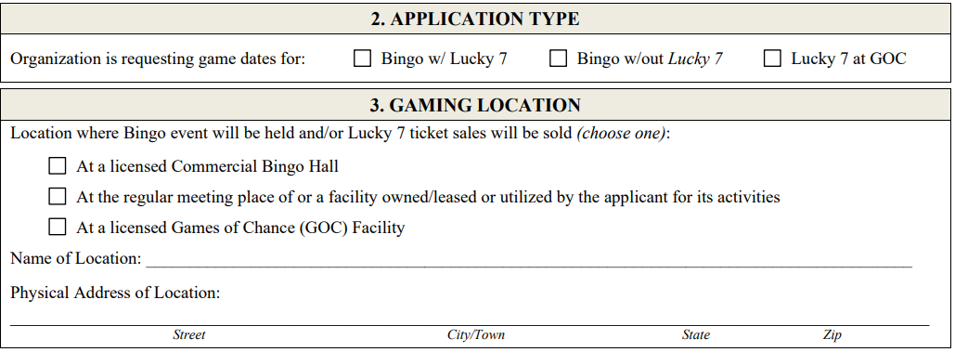
Monthly Lucky 7 license application Sections 2 & 3
Indicate which type of license is being sought:
Bingo w/ Lucky 7
Bingo w/o Lucky 7
Lucky 7 at GOC
Indicate which type of location Lucky 7 will be held at:
Name of Location
Provide the name of the location where the tickets are being sold.
Physical Address
Provide the physical address where the tickets are being sold
Commercial Hall
Licensed Game Room
Regular Meeting Place

Slide 9
Monthly Lucky 7 license application Section 4
Enter all game dates that are being requested.
Organizations may hold up to 16 game dates per month.
All game dates must be within the same calendar month.
A separate application must be submitted for each month.

Slide 10
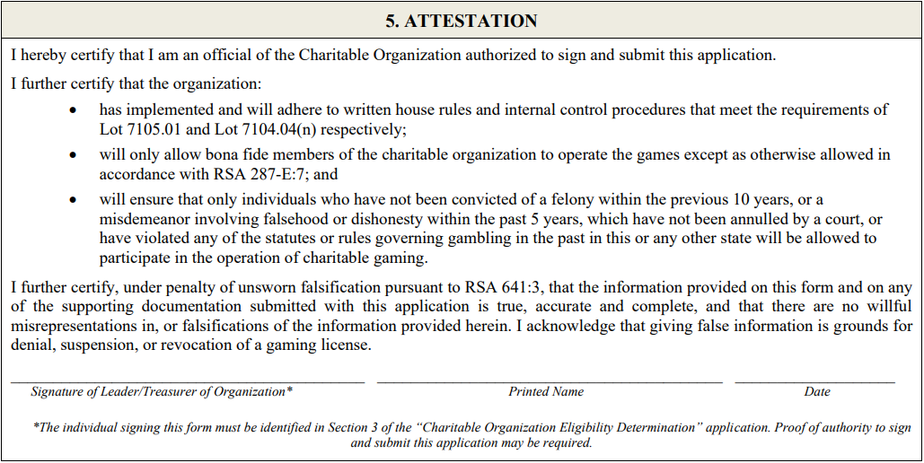
Monthly Lucky 7 license application Section 5
Must be signed by either the leader or treasurer of the organization.

Slide 11
FEES
Include the following payment based on your selection in section 2:
Bingo & Lucky 7 – payment of $25.00 per bingo game date plus a $10.00 lucky 7 license fee.
Lucky 7 at GOC – payment of a $10.00 lucky 7 license fee.
Checks and or money orders must be made payable to “NH LOTTERY COMMISSION”.

Slide 12
Compliance requirements
Internal Controls
Inventory
Monthly Financial Reports

Slide 13
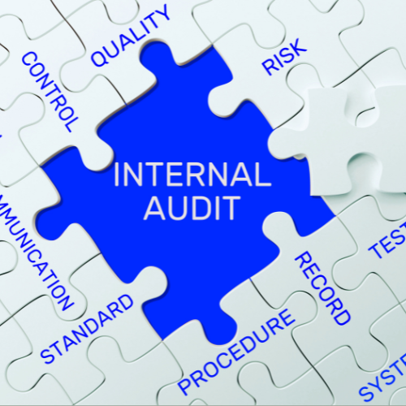
Internal controls
Internal controls help prevent and detect fraudulent activities.
An organization can reduce the likelihood of lost revenue by putting procedures in place that control the authorization, accountability, and safekeeping of assets.
Key controls include:
Segregation of duties
Controlling access to assets including cash and tickets
Managing inventory of tickets
Verifying and documenting ticket sales and voids.
Restricting access to sales and accounting records
Recording, tracking and reconciling prize payouts
Securing and accounting for all operating funds

Slide 14
INTERNAL CONTROLS All Charities licensed to participate in Bingo and/or Lucky 7 must write and maintain internal controls
Internal controls should contain at least the following descriptions of:
The roles of the individuals running Bingo/L7 operations;
Record keeping procedures;
How sensitive keys are controlled;
The physical inventory system;
Sales procedures, including processes for cash handling;
The process for calculating player prizes and daily gaming revenue;
Any variances and an explanation of the root causes;
How progressive tickets are tracked;
How free play is tracked, and;
How systems are password protected.

Slide 15
INVENTORY: PERPETUAL & PHYSICAL
Inventory is an essential internal control that ensures that tickets remain secure from the time they are received until the time they are sold
Without inventory the organization’s profits and the integrity of the game are at risk
A person that performs the Perpetual Inventory cannot also participate in the physical inventory
Perpetual and Physical inventories must be periodically compared and reconciled to ensure accuracy and detect theft
Perpetual
A perpetual inventory is a system that continuously records and tracks inventory changes in real time.
Physical
A physical inventory counts the actual number of tickets a charity possesses and must be done once per month

Slide 16
ANNUAL INVENTORY REPORTING REQUIREMENT
All licensed organizations must submit a copy of their completed June physical inventor to the Division
This report must be submitted no later than July 15th of each year.
Electronic Lucky 7 inventory should not be included in the inventory.
If the organization has ceased operations and/or has no inventory they must indicate such on the form.

Slide 17
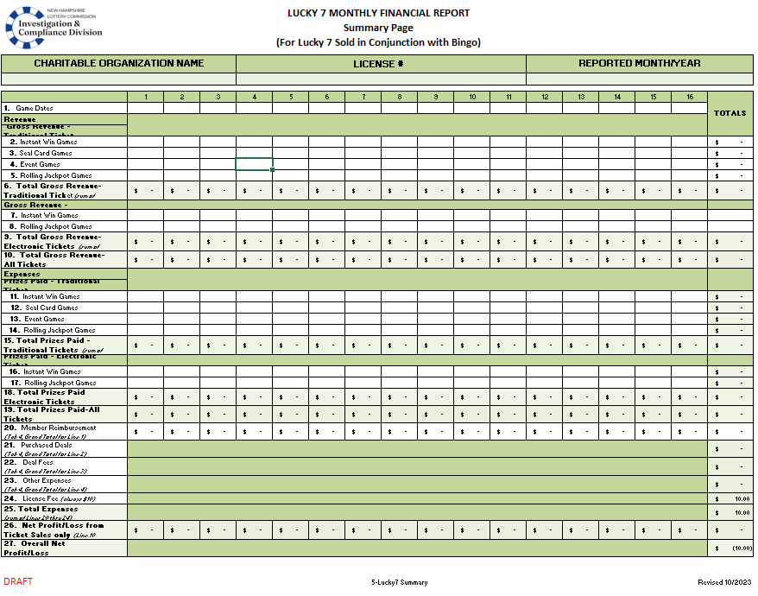
MONTHLY FINANCIAL REPORTS (MFRS) Tickets sold during a Bingo event
MFRs must be submitted monthly to report revenue and expenses related to Lucky 7 activities.
Monthly Lucky 7 licensees who play in conjunction with a Bingo event must use BL7MFR form.
The report must be completed and submitted electronically. DO NOT complete by hand.
DO NOT enter incorrect data. Falsifying a report subjects the licensee to fines and penalties.
The completed forms and all source documents must be maintained for at least 2 years and be made available upon request.

Slide 18
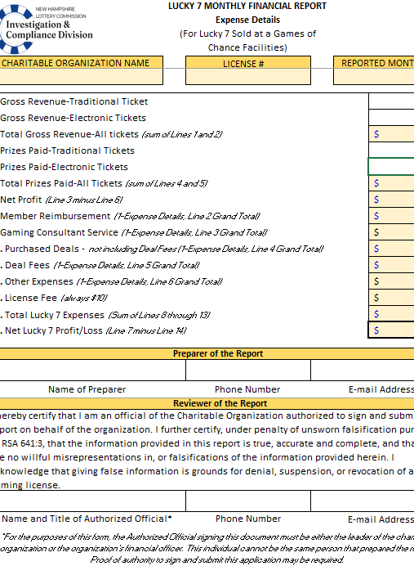
MFRs must be submitted monthly to report revenue and expenses related to Lucky 7 activities.
The report must be completed and submitted electronically. DO NOT complete by hand.
DO NOT enter incorrect data. Falsifying a report subjects the licensee to fines and penalties.
The completed forms and all source documents must be maintained for at least 2 years and be made available upon request.
Monthly Lucky 7 licensees who play without a Bingo event must use L7MFR-GOC form.
MONTHLY FINANCIAL REPORTS (MFRS) Tickets sold without a Bingo event

Slide 19
Monthly Financial Report Due dates
The MFR is due 15 days after the final day of the month licensed (see chart to the right).
Late or incomplete submittals will be considered non-compliant and could affect future licensure. If no Lucky 7 tickets are sold during a licensed month, the MFR must be submitted indicating zero sales.
MONTH LICENSED | DUE DATE
JANUARY | FEBRUARY 15
FEBRUARY | MARCH 15
MARCH | APRIL 15
APRIL | MAY 15
MAY | JUNE 15
JUNE | JULY 15
JULY | AUGUST 15
AUGUST | SEPTEMBER 15
SEPTEMBER | OCTOBER 15
OCTOBER | NOVEMBER 15
NOVEMBER | DECEMBER 15
DECEMBER | JANUARY 15

