Slide 1
GAMES OF CHANCE
CHARITABLE ORGANIZATION

Slide 2
OBJECTIVE
The purpose of this presentation is to aid in becoming an eligible Games of Chance charity.
Topics to review will include:
Eligibility Determination
Game Room locations
Standard Agreement overview
Licensing process

Slide 3
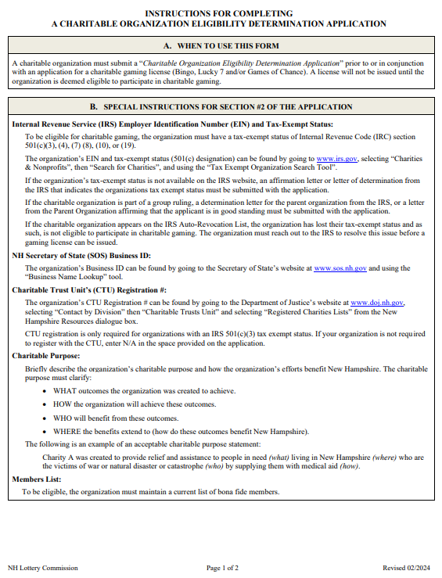
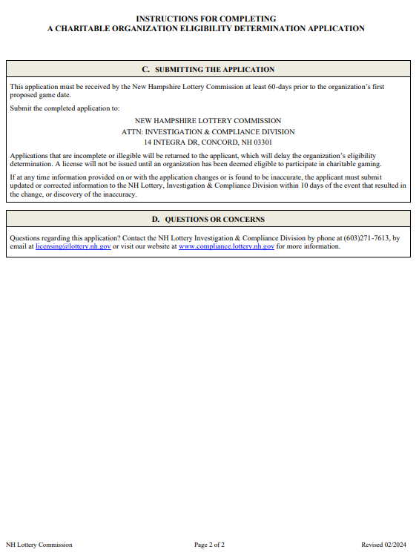
ELIGIBILITY DETERMINATION
An organization must be found eligible to receive a charitable gaming license
A charity is deemed eligible for the entire calendar year in which the determination was made.
One application can be submitted for all license types
For more information on this form please see the corresponding PowerPoint

Slide 4
GAME ROOM LOCATIONS
Contact one of the game rooms and ask to speak with the Charity Coordinator.
All game room addresses, and phone numbers are listed in alphabetical order on our website.

Slide 5
INFORMATION TO KNOW PRIOR TO CHOOSING A GAMING LOCATION
QUESTIONS TO ASK
What does the room charge for rent?
Is there a waiting list for charities?
Can the game room offer the full 10 days?
What is expected of an organization?
What are the average funds received by a charitable organization?

Slide 6
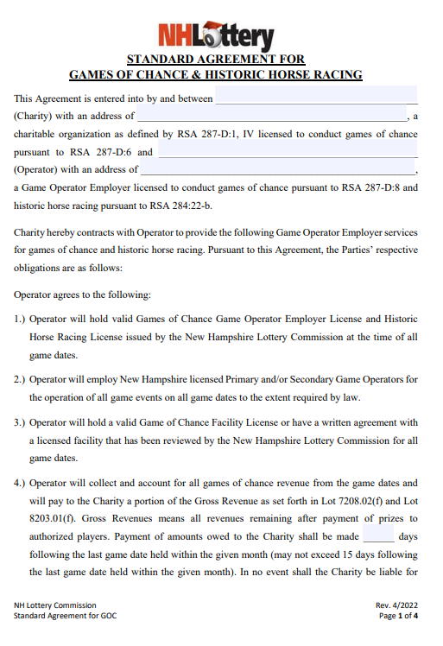
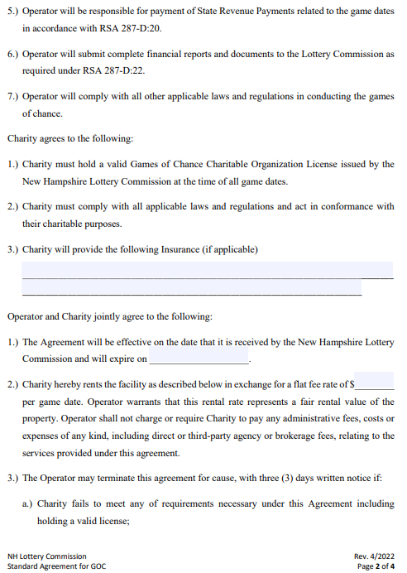
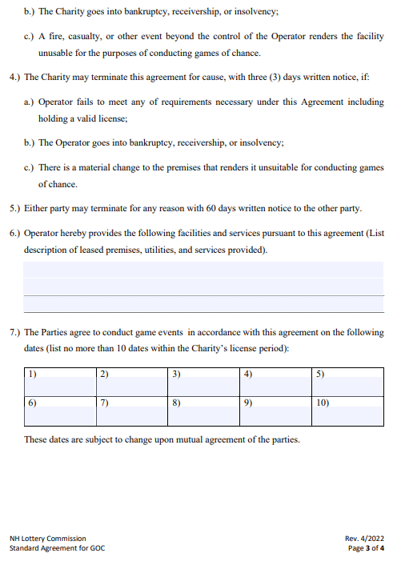
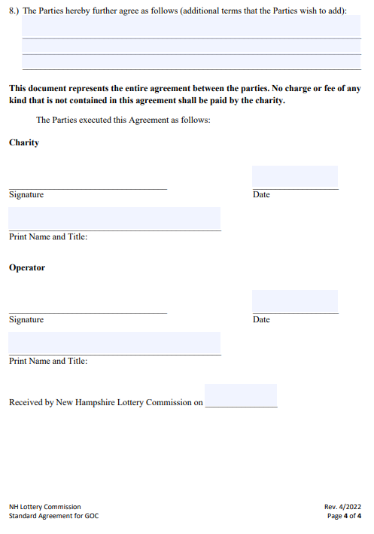
STANDARD AGREEMENTS GOC & HHR
The Standard Agreement is provided to the charity by the Game Room’s Charity Coordinator.
This agreement is a legal document between the charity and the Game Room.
It is the charity’s responsibility to read and understand all aspect of the document prior to signing.
A Standard Agreement, signed by all parties, must be received by the Lottery Commission prior to license approval.

Slide 7
LICENSURE LIFE CYCLE
Submit to the Lottery Commission at least 60 but no more than 180 days in advance;
Application
$50 fee
Standard Agreement
License approved
License is emailed to the Game Room to be displayed
Disbursement of revenue
Once game dates have passed, the Game Room must pay the charity by the 15th of the following month

