Slide 1
CHARITABLE GAMING
CHARITABLE ORGANIZATION ELIGIBILITY DETERMINATION
LUCKY 7
BINGO
GAMES OF CHANCE

Slide 2
OBJECTIVE
The purpose of this presentation is to aid in determining whether an organization is eligible to participate in New Hampshire charitable gaming.
Topics to review will include:
IRS requirements
Secretary of State (SOS) requirements
Charitable Trust Unit (CTU) requirements
The process of submitting an application

Slide 3
REQUIREMENTS FOR ELIGIBILITY
To be eligible for a charitable gaming license the organization must:
Posses a tax-exempt status under 501(c)(3), (4), (7), (8), (10), or (19) and not appear on the IRS Auto-Revocation List;
Be registered and in good standing as a “Domestic Non-Profit” with the NH Secretary of State (SOS) for at least one year; and
Be registered and in good standing with the Department of Justice – Charitable Trust Unit (CTU) for at least one year if required to do so per RSA 7:19-32-a.

Slide 4
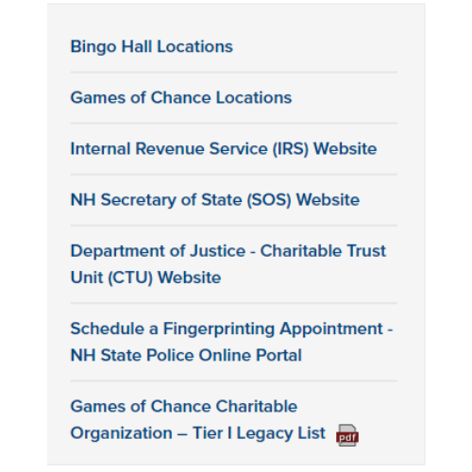
NEW HAMPSHIRE LOTTERY COMMISSION INVESTIGATION AND COMPLIANCE DIVISION WEBSITE
Links to the IRS, SOS, and CTU are located on the right side of the division’s home page.
https://www.compliance.lottery.nh.gov/

Slide 5
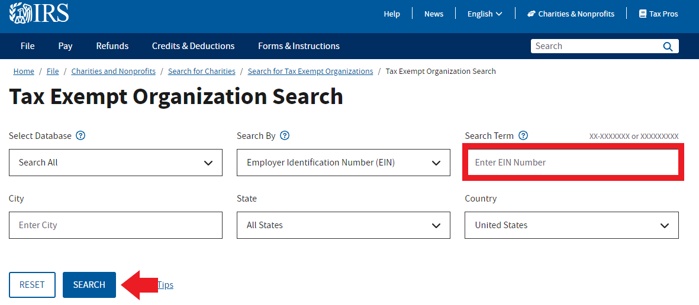
https://apps.irs.gov/app/eos/
INTERNAL REVENUE SERVICE (IRS) WEBSITE
The tax-exempt search tool is used to view the following:
Determination letters
Form 990 series returns
Form 990-N (e-postcard)
Whether tax-deductible contribution can be received (Pub. 78 data)
Whether the organization appears on the Auto-Revocation List
TAX-EXEMPT ORGANIZATION SEARCH TOOL
Organizations should enter their EIN into the above highlighted box and then click “search” to look up their documents.

Slide 6
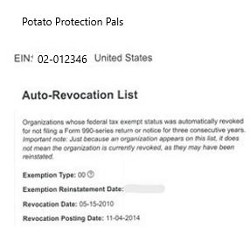
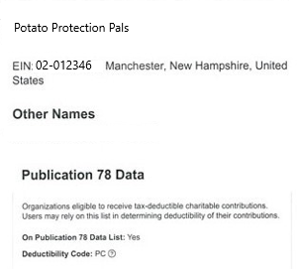
INTERNAL REVENUE SERVICE (IRS)
AUTO-REVOCATION LIST
What does this mean?
Auto-Revocation means that an organization’s tax-exempt status has been automatically revoked.
Why does this happen?
Auto-Revocation happens when an organization fails to file the required return or notice for 3 consecutive years.
How does this apply to licensure eligibility?
Organizations on the Auto-Revocation List are not eligible for a charitable gaming license.

Slide 7
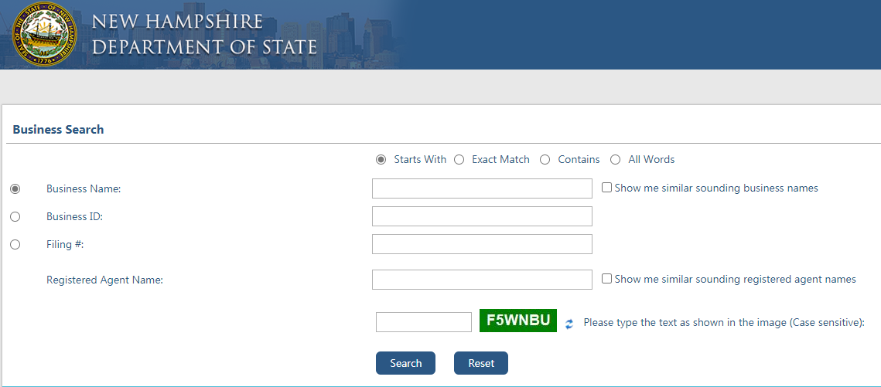
https://quickstart.sos.nh.gov/online/BusinessInquire
NH SECRETARY OF STATE (SOS) WEBSITE
The business search tool is used to view the following:
Business Type
Business Status
Business Creation Date
Business Name
Business ID
SECRETARY OF STATE BUSINESS SEARCH TOOL
Organizations should enter data into one of the above search fields, “Business Name”, “Business ID”, or “Filing #”.
Enter the captcha from the green box and then click “search” to look up their information.

Slide 8
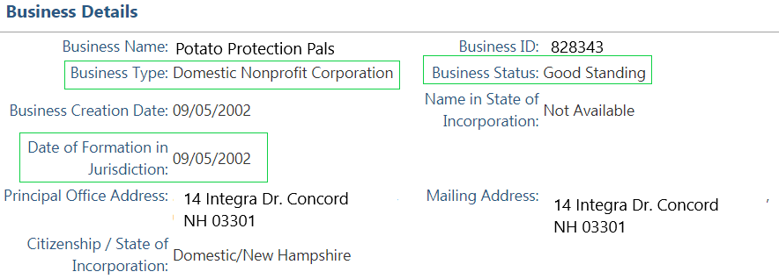
NH SECRETARY OF STATE (SOS)
Business Type
Business Status
Date of Formation in Jurisdiction
A business type of
“Domestic Non-Profit” is required.
A business status of
“Good Standing” is required.
A “Date of Formation in Jurisdiction” must be at least 1 year prior to the first game date.

Slide 9
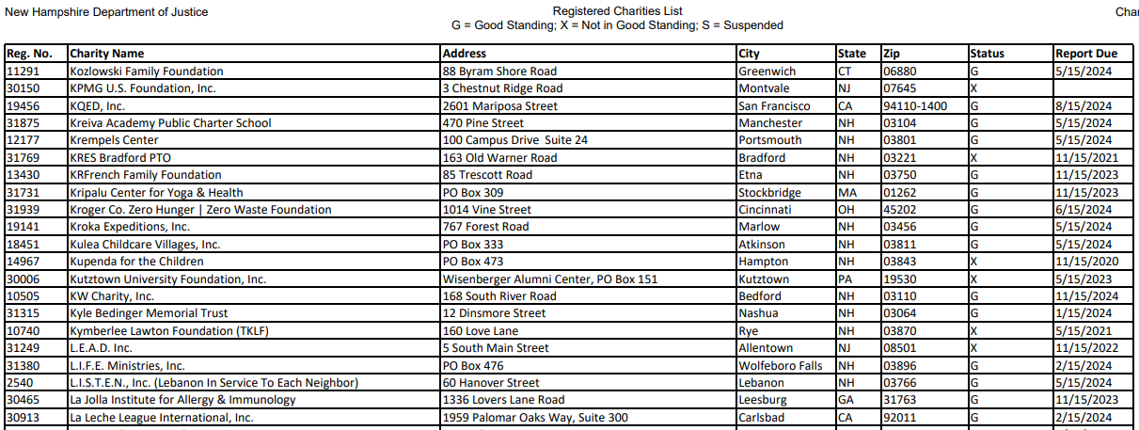
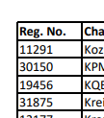
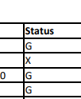
https://www.doj.nh.gov/charitable-trusts/documents/registered-charities.pdf
CHARITABLE TRUST UNIT (CTU) WEBSITE
501(c)(3) organizations must register with the CTU.
REGISTERED CHARITIES LIST IN .PDF FORMAT
Registration is optional for all other charities.
Eligible 501(c)(3) organizations are those that:
Appear on the most recent “Registered Charities” list (updated regularly), and;
Have a status of “G” (Good Standing).
Organizations can use CTRL+F on their keyboard to search for their organization’s name, or CTU registration number.

Slide 10
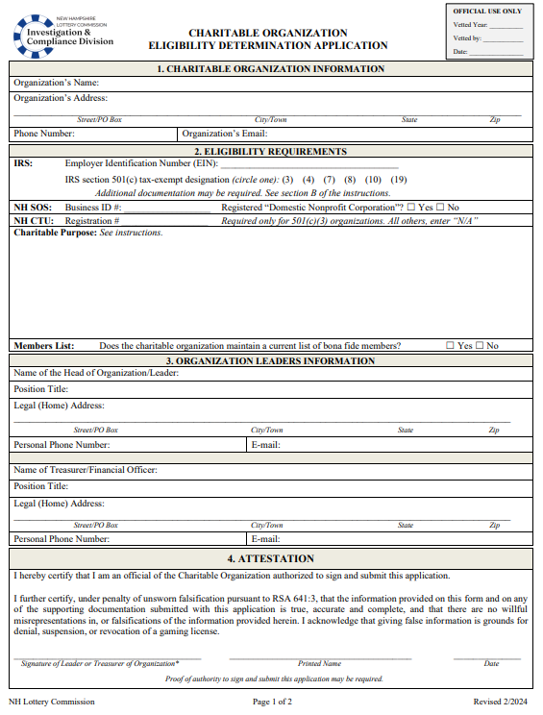
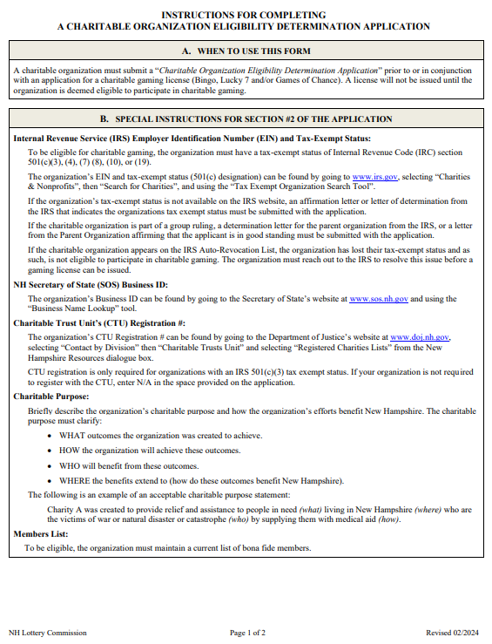
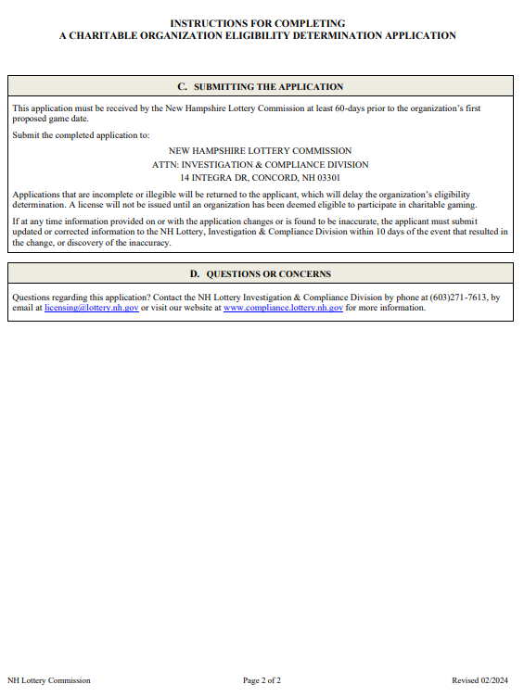
SUBMITTING AN ELIGIBILITY DETERMINATION APPLICATION
An organization must be found eligible to receive a charitable gaming license
A charity is deemed eligible for the entire calendar year in which the determination was made.
One application can be submitted for all license types

Slide 11
ELIGIBILITY DETERMINATION APPLICATION
Section 1
ORGANIZATION’S NAME
This must read exactly how it is registered with the IRS, SOS, and CTU
ORGANIZATION’S PHONE NUMBER & EMAIL
Phone number and Email must belong to the organization and must be actively monitored.
ORGANIZATION’S ADDRESS
This must be the organization’s official mailing address.

Slide 12
ELIGIBILITY DETERMINATION APPLICATION Section 2 - IRS
Use the IRS, SOS, and CTU websites (provided earlier) to obtain the required information for section 2.
In IRS enter the EIN associated with the charitable organization, then circle the IRS assigned tax-exempt designation.
If IRS status is part of a group ruling (example: churches, fraternal organizations) the charitable organization will need to submit additional documents. See section B of the instructions.

Slide 13
ELIGIBILITY DETERMINATION APPLICATION Section 2 – SOS, CTU, Charitable Purpose, Members List
NH SOS BUSINESS ID #
Business ID # is the number provided by the NH SOS when a charity registers with them.
NH CTU REGISTRATION #
Registration # is the number provided by the NH CTU when a charity registers with them.
REGISTERED DOMESIC NON-PROFIT
Check “Yes” or “No”
Administrative Rule requires that charities be registered as “Domestic Non-Profits”
CHARITABLE PURPOSE
The charitable purpose must clarify:
• WHAT outcomes the organization was created to achieve.
• HOW the organization will achieve these outcomes.
• WHO will benefit from these outcomes.
• WHERE the benefits extend to (how do these outcomes benefit New Hampshire).
MEMBERS LIST
Check “Yes” or “No”
Administrative Rule requires that charities licensed for bingo and/or lucky 7 maintain a members list.
Only 501(c)(3) organizations. All others enter “N/A”

Slide 14
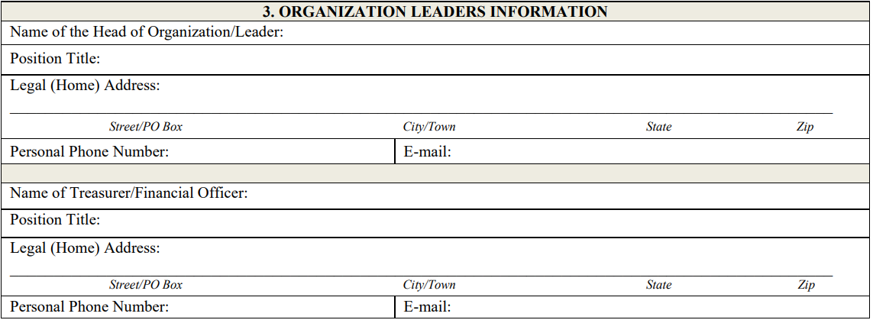
ELIGIBILITY DETERMINATION APPLICATION Section 3
Name of the Head of Organization/Leader
Accurate contact information is critical should an event take place that need immediate action.
Do not enter the names of any individuals other than the elected Head of Organization and Treasurer
The address, phone number, and email must be specific to the individual.
Name of the Treasurer/Financial Officer

Slide 15
ELIGIBILITY DETERMINATION APPLICATION Section 4
Must be signed by either individual listed in Section 3.

Slide 16
ATTENTION
If at any time a charity:
Loses its status of good standing with:
NH Charitable Trust Unit (CTU) or
NH Secretary of State (SOS), or
Appears on the IRS auto-revocation list,
They are required to inform the NH Lottery Commission within 15 days per Lot 7003.02(g) (Bingo), Lot 7103.02(g) (Lucky 7), and Lot 7205.03 (Games of Chance).

