Slide 1
MONTHLY BINGO LICENSES
CHARITABLE GAMING

Slide 2
The purpose of this presentation is to aid in completing and submitting a Monthly Bingo license application.
Topics to review will include:
Locations for events
Introduction to consultants
Monthly Bingo license application
Compliance expectations
Internal Controls
Monthly Financial Reports (MFRs)
OBJECTIVE

Slide 3
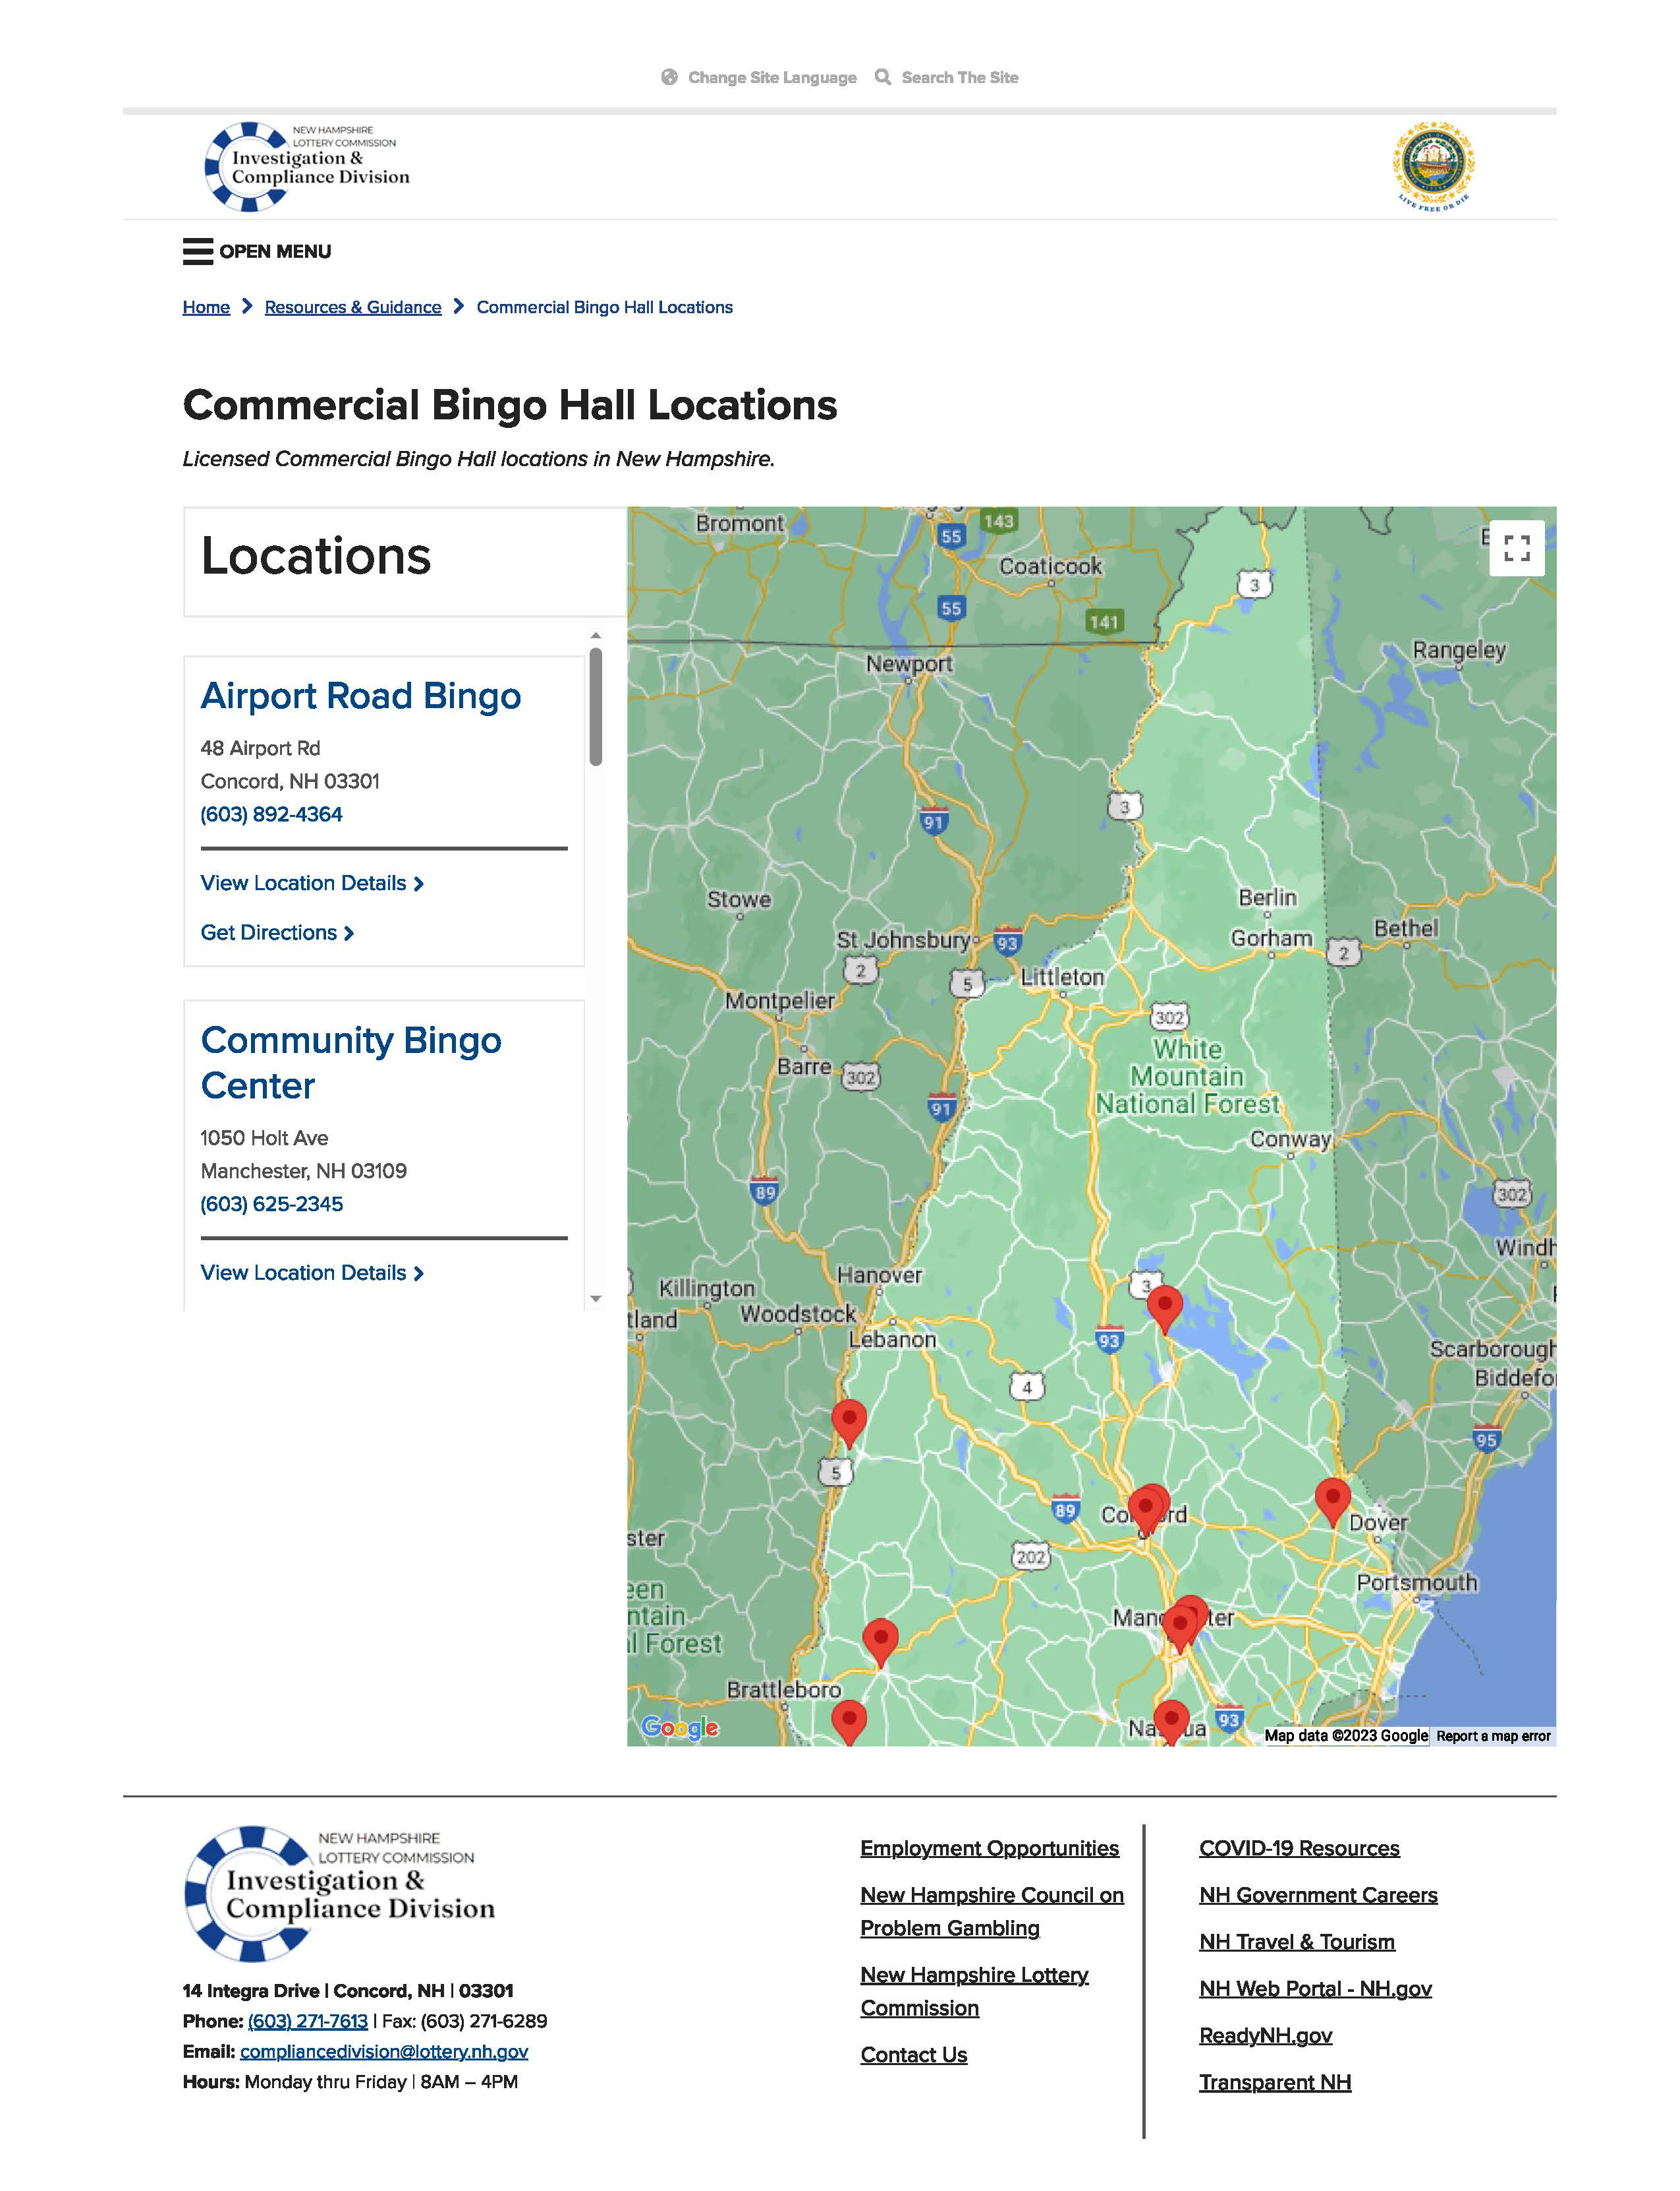
LOCATIONS FOR EVENTS
Find a Commercial Hall to Host
Bingo events may be played at the organization’s regular meeting place/or a facility owned, leased, or utilized by the organization for activities

Slide 4
INFORMATION TO KNOW PRIOR TO CHOOSING A COMMERCIAL HALL
What does the room charge for rent?
Is there a waiting list for charities?
Can the game room offer the full 16 days?
What is expected of an organization?
What are the average funds received by a charitable organization?
Does the gaming location provide consulting services?

Slide 5
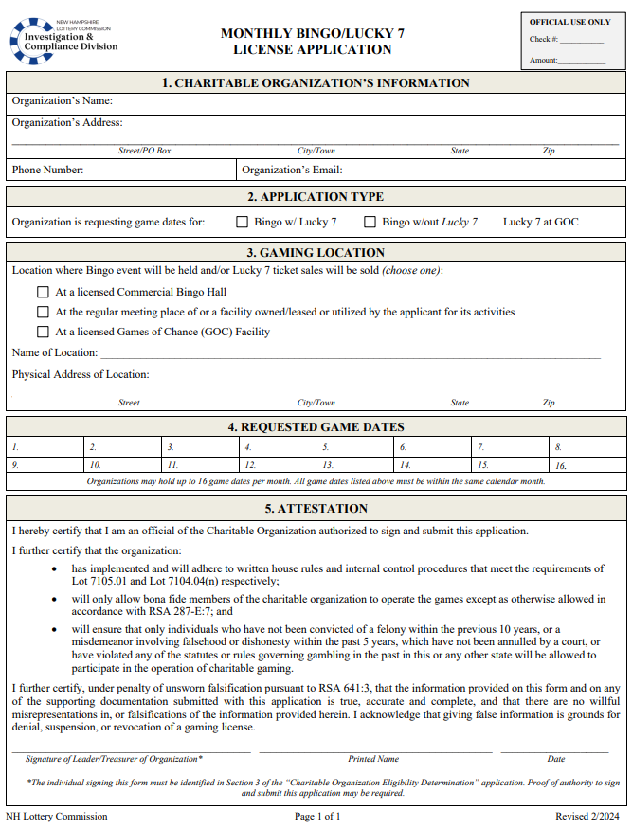
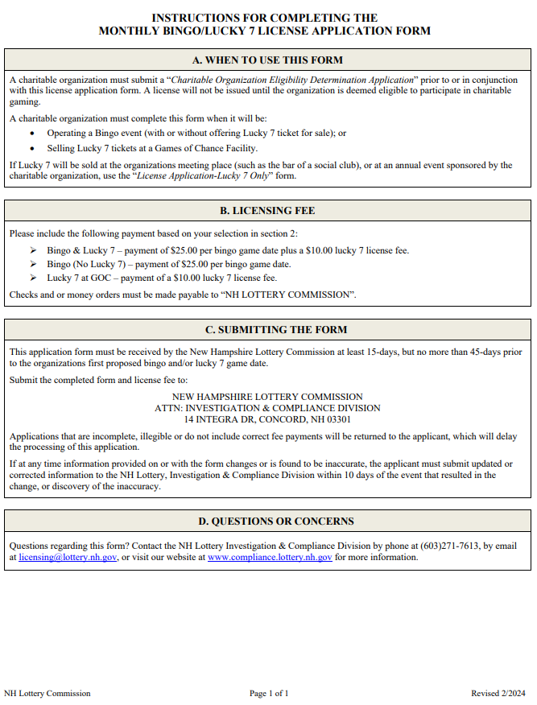
MONTHLY BINGO LICENSE APPLICATION
An Eligibility Determination Application must be submitted prior to or with this application. For more information regarding the Eligibility Determination Application, see the corresponding PowerPoint.

Slide 6
MONTHLY BINGO LICENSE APPLICATION SECTION 1
ORGANIZATION’S NAME
This must read exactly how it is registered with the IRS, SOS, and CTU
ORGANIZATION’S ADDRESS
This must be the organization’s official mailing address.
ORGANIZATION’S PHONE NUMBER & EMAIL
Phone number and Email must belong to the organization and must be actively monitored.

Slide 7
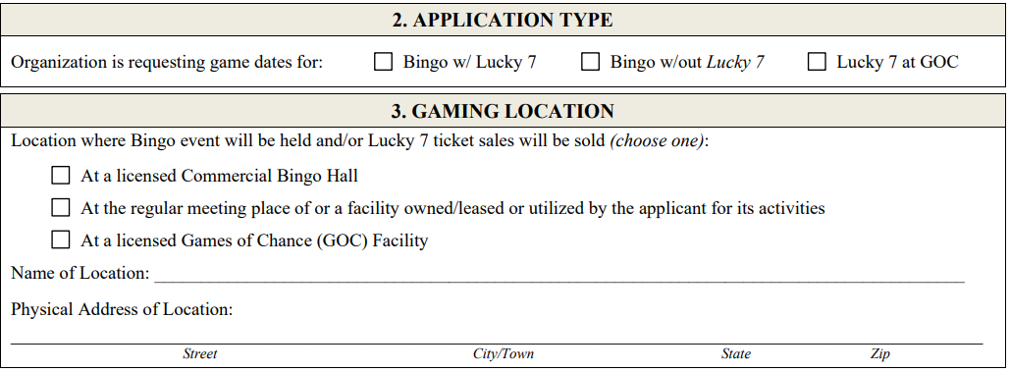
MONTHLY BINGO LICENSE APPLICATION SECTIONS 2 & 3
Indicate which type of license is being sought:
Bingo w/ Lucky 7
Bingo w/o Lucky 7
Lucky 7 at GOC
Indicate which type of location Lucky 7 will be held at:
Name of Location
Provide the name of the location where the tickets are being sold.
Provide the physical address where the tickets are being sold
Commercial Hall
Licensed Game Room
Regular Meeting Place
Physical Address

Slide 8
Enter all game dates that are being requested.
Organizations may hold up to 16 game dates per month.
All game dates must be within the same calendar month.
A separate application must be submitted for each month.
MONTHLY
BINGO LICENSE APPLICATION
SECTION 4

Slide 9
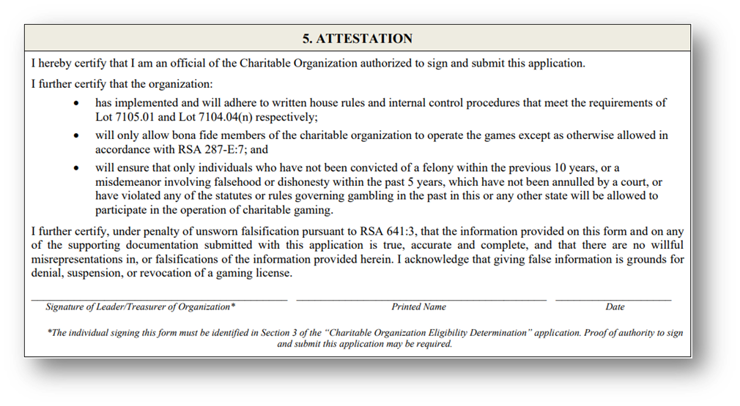
MONTHLY BINGO LICENSE APPLICATION SECTION 5
Must be signed by either the leader or treasurer of the organization.

Slide 10
FEES
Include the following payment based on your selection in section 2:
Bingo & Lucky 7 – payment of $25.00 per bingo game date plus a $10.00 lucky 7 license fee.
Checks and or money orders must be made payable to “NH LOTTERY COMMISSION”.

Slide 11
COMPLIANCE REQUIREMENTS Internal Controls Inventory Monthly Financial Reports

Slide 12
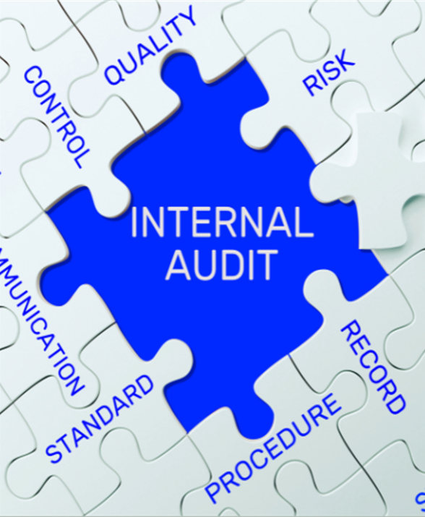
Internal controls help prevent and detect fraudulent activities.
An organization can reduce the likelihood of lost revenue by putting procedures in place that control the authorization, accountability, and safekeeping of assets.
Key controls include:
Segregation of duties
Controlling access to assets including cash and tickets
Managing inventory of tickets
Verifying and documenting ticket sales and voids.
Restricting access to sales and accounting records
Recording, tracking and reconciling prize payouts
Securing and accounting for all operating funds
INTERNAL CONTROLS

Slide 13
INTERNAL CONTROLS All Charities licensed to participate in Bingo and/or Lucky 7 must write and maintain internal controls
Internal controls should contain at least the following descriptions of:
The roles of the individuals running Bingo/L7 operations;
Record keeping procedures;
How sensitive keys are controlled;
The physical inventory system;
Sales procedures, including processes for cash handling;
The process for calculating player prizes and daily gaming revenue;
Any variances and an explanation of the root causes;
How progressive tickets are tracked;
How free play is tracked, and;
How systems are password protected.

Slide 14
INVENTORY: PERPETUAL & PHYSICAL
Inventory is an essential internal control that ensures that tickets remain secure from the time they are received until the time they are sold
Without inventory the organization’s profits and the integrity of the game are at risk
A person that performs the Perpetual Inventory cannot also participate in the physical inventory
Perpetual and Physical inventories must be periodically compared and reconciled to ensure accuracy and detect theft
Perpetual
A perpetual inventory is a system that continuously records and tracks inventory changes in real time.
Physical
A physical inventory counts the actual number of tickets a charity possesses and must be done once per month

Slide 15
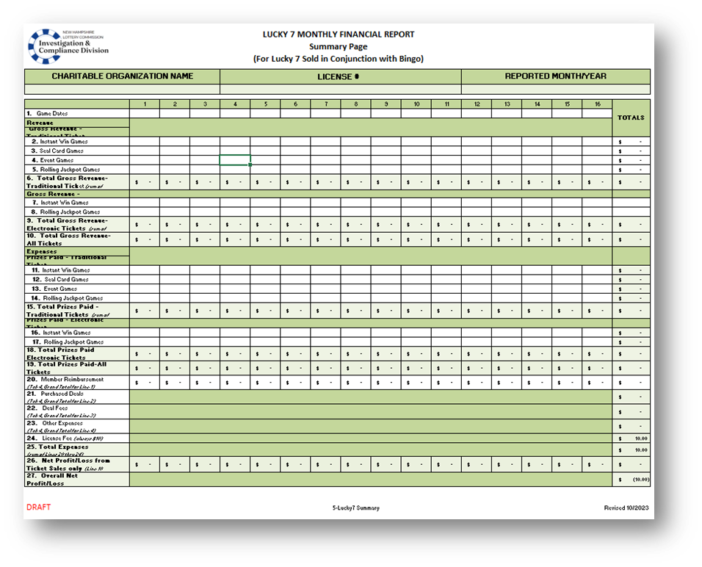
MONTHLY FINANCIAL REPORTS (MFRS) Tickets sold DURING A BINGO EVENT
MFRs must be submitted monthly to report revenue and expenses related to Bingo activities.
The report must be completed and submitted electronically. DO NOT complete by hand.
The cover sheet page must be submitted with any Carry-Over Cover-All or Winner-Take-All taxes.
DO NOT enter incorrect data. Falsifying a report subjects the licensee to fines and penalties.
The completed forms and all source documents must be maintained for at least 2 years and be made available upon request.

Slide 16
MONTHLY FINANCIAL REPORT DUE DATES
MONTH LICENSED | DUE DATE
JANUARY | FEBRUARY 15
FEBRUARY | MARCH 15
MARCH | APRIL 15
APRIL | MAY 15
MAY | JUNE 15
JUNE | JULY 15
JULY | AUGUST 15
AUGUST | SEPTEMBER 15
SEPTEMBER | OCTOBER 15
OCTOBER | NOVEMBER 15
NOVEMBER | DECEMBER 15
DECEMBER | JANUARY 15
The MFR is due 15 days after the final day of the month licensed (see chart to the right).
Late or incomplete submittals will be considered non-compliant and could affect future licensure. If no Bingo games are held during a licensed month, the MFR must be submitted stating such.

