Slide 1
GAMES OF CHANCE (GOC) BADGE REQUEST FORM
CHARITABLE GAMING

Slide 2
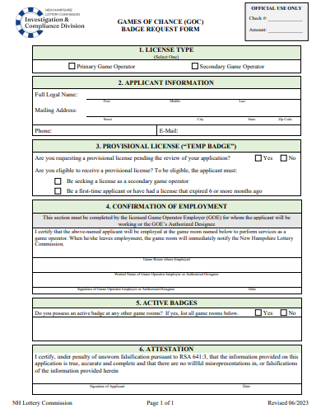
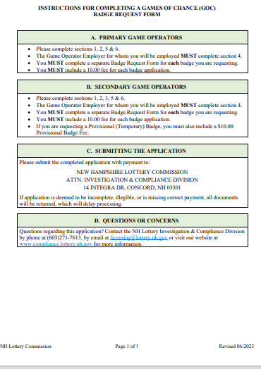
OBJECTIVE
The purpose of this presentation is to aid in completing and submitting a Games of Chance (GOC) Badge Request Form
Game Operators must submit a badge request for every room where they are employed.

Slide 3
GAMES OF CHANCE (GOC) BADGE REQUEST FORM SECTIONS 1 & 2
License Type
Primary Game Operator
Secondary Game Operator
Applicant Information
Applicant must provide their full legal name, mailing address, phone number, and email
Indicate which type of license is being sought:

Slide 4
GAMES OF CHANCE (GOC) BADGE REQUEST FORM SECTION 3 – SECONDARY GAME OPERATORS ONLY
Provisional License “Temp Badge”
Applicants must indicate whether they are requesting a temporary badge by checking off “yes” or “no”
Applicants must indicate whether they are eligible for a temporary badge by carefully reading and then checking off the scenario which makes them eligible.

Slide 5
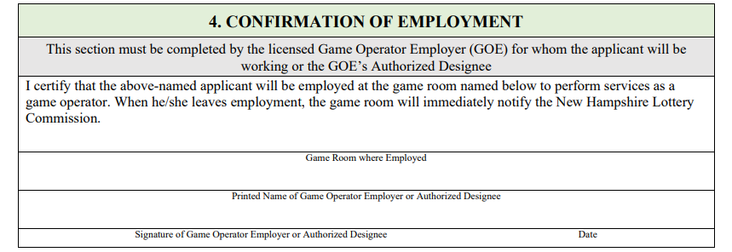
GAMES OF CHANCE (GOC) BADGE REQUEST FORM SECTION 4
Confirmation of Employment
The Game Room in which the applicant will be employed must fill this section out.

Slide 6
GAMES OF CHANCE (GOC) BADGE REQUEST FORM SECTIONS 5 & 6
List ALL New Hampshire Game Rooms where applicant currently works. This section must include AT LEAST one Game Room
Attestation
Carefully read the attestation before signing
Active Badges

Slide 7
FEES
A payment, by check or money order, in the amount of:
Checks and/or money orders must be made payable to:
“NH LOTTERY COMMISSION”
$10.00 for each badge application.
If applicant is requesting a Provisional (Temporary) Badge, they must also include a $10.00 Provisional Badge Fee

