Slide 1
ANNUAL/ SPECIAL EVENT LUCKY 7 LICENSES
CHARITABLE GAMING

Slide 2
OBJECTIVE
The purpose of this presentation is to aid in completing and submitting an Annual Lucky 7 license application.
Topics to review will include:
Different types of Lucky 7 licenses
Annual Lucky 7 license application
Compliance expectations
Internal Controls
Inventory
Monthly Financial Reports

Slide 3
TYPES OF LUCKY 7 LICENSES
Annual
Not associated with bingo or games of chance
Can be played every day
Played at the organization’s regular meeting place/or a facility owned, leased, or utilized by the organization for activities
Issued annually for up to 12 months within a given calendar year
Monthly
Must be sold at a bingo event or licensed games of chance facility
Limited to 16 game dates per month
Can be played at a commercial hall or other approved location
Special Events
Sponsored or co-sponsored by an organization
Issued once per year for up to four consecutive days
Issued monthly
Not associated with bingo or games of chance

Slide 4
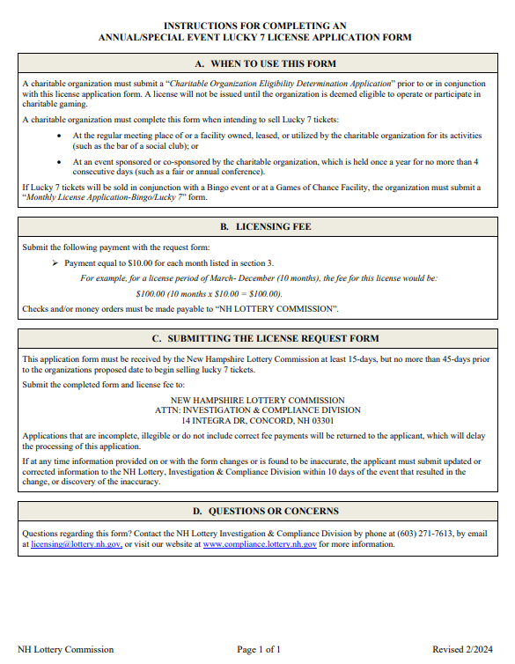
ANNUAL/ SPECIAL EVENT LUCKY 7 LICENSE APPLICATION
An Eligibility Determination Application must be submitted prior to or with this application. For more information regarding the Eligibility Determination Application, see the corresponding powerpoint.

Slide 5
ANNUAL/SPECIAL EVENT LUCKY 7 LICENSE APPLICATION Section 1
ORGANIZATION’S NAME
This must read exactly how it is registered with the IRS, SOS, and CTU
ORGANIZATION’S PHONE NUMBER & EMAIL
Phone number and Email must belong to the organization and must be actively monitored.
ORGANIZATION’S ADDRESS
This must be the organization’s official mailing address.

Slide 6
ANNUAL/SPECIAL EVENT LUCKY 7 LICENSE APPLICATION Section 2
Indicate which type of license is being sought
Annual
Special Event
Name of Location
Provide the name of the location where the tickets are being sold.
Physical Address
Provide the physical address where the tickets are being sold

Slide 7
ANNUAL/SPECIAL EVENT LUCKY 7 LICENSE APPLICATION Section 3
Choose one of the following:
Annual License
Can be issued for a full calendar year
Enter the starting month and ending month of the requested license
Special Event License
Is only issued once a year
Maximum of 4 consecutive days
Enter the name of the event
Enter the ticket sale start date and end date

Slide 8
ANNUAL/SPECIAL EVENT LUCKY 7 LICENSE APPLICATION Section 4
Must be signed by either the leader or treasurer of the organization.

Slide 9
FEES
Submit the following payment with the request form:
Payment equal to $10.00 for each month listed in section 3.
For example, for a license period of March- December (10 months), the fee for this license would be: $100.00 (10 months x $10.00 = $100.00).
Checks and/or money orders must be made payable to:
“NH LOTTERY COMMISSION”.

Slide 10
COMPLIANCE REQUIREMENTS
Internal Controls
Inventory
Monthly Financial Reports

Slide 11
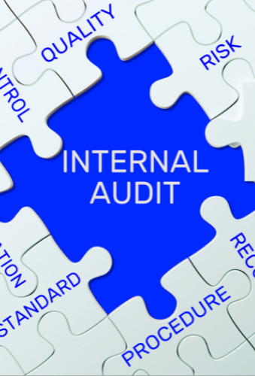
INTERNAL CONTROLS
Internal controls help prevent and detect fraudulent activities.
An organization can reduce the likelihood of lost revenue by putting procedures in place that control the authorization, accountability, and safekeeping of assets.
Key controls include:
Segregation of duties
Verifying and documenting ticket sales and voids.
Recording, tracking and reconciling prize payouts
Securing and accounting for all operating funds
Controlling access to assets including cash and tickets
Managing inventory of tickets
Restricting access to sales and accounting records

Slide 12
INTERNAL CONTROLS All Charities licensed to participate in bingo and/or lucky 7 must write and maintain internal controls
Internal controls should contain at least the following descriptions of:
The roles of the individuals running Bingo/L7 operations;
Record keeping procedures;
How sensitive keys are controlled;
The physical inventory system;
Sales procedures, including processes for cash handling;
The process for calculating player prizes and daily gaming revenue;
Any variances and an explanation of the root causes;
How progressive tickets are tracked;
How free play is tracked, and;
How systems are password protected.

Slide 13
INVENTORY: PERPETUAL & PHYSICAL
Inventory is an essential internal control that ensures that tickets remain secure from the time they are received until the time they are sold
Without inventory the organization’s profits and the integrity of the game are at risk
A person that performs the Perpetual Inventory cannot also participate in the physical inventory
Perpetual and Physical inventories must be periodically compared and reconciled to ensure accuracy and detect theft
Perpetual
A perpetual inventory is a system that continuously records and tracks inventory changes in real time.
Physical
A physical inventory counts the actual number of tickets a charity possesses and must be done once per month

Slide 14
ANNUAL INVENTORY REPORTING REQUIREMENT
All licensed organizations must submit a copy of their completed June physical inventor to the Division
This report must be submitted no later than July 15th of each year.
Electronic Lucky 7 inventory should not be included in the inventory.
If the organization has ceased operations and/or has no inventory they must indicate such on the form.

Slide 15
MONTHLY FINANCIAL REPORTS(MFRS)
MFRs must be submitted monthly to report revenue and expenses related to Lucky 7 activities.
Annual/Special Event Lucky 7 licensees must use the L7MFR-Clubs form.
The report must be completed and submitted electronically. DO NOT complete by hand.
DO NOT enter incorrect data. Falsifying a report subjects the licensee to fines and penalties.
The completed L7MFR-Clubs and all source documents must be maintained for at least 2 years and be made available upon request.

Slide 16
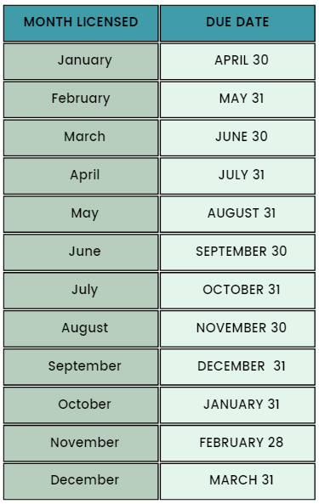
MONTHLY FINANCIAL REPORT DUE DATES
Special Event License Holders:
Annual License Holders:
The MFR must be submitted by the 15th day following the end of the reported month.
The MFR is due 90 days after the final day of the month licensed (see chart to the right).
Late or incomplete submittals will be considered non-compliant and could affect future licensure. If no Lucky 7 tickets are sold during a licensed month, the MFR must be submitted indicating zero sales.

